Slide 1
GCOA & WSIS 2021 HACKATHON PRESENTATION AGEING BETTER WITH ICTs: Building a Brighter Future for Older Persons through ICT Innovation
Team: Pied Piper: SIDDHARTH SINHA, SANJANA SINHA
(sid3345@gmail.com)
Country: India

Slide 2
Some Background
The Hackathon is part of the WSIS Forum 2021 ICTs & Older Persons track, led by the Global Coalition on Aging with the support of the ITU.
The Hackathon is linked to the WSIS Action Lines and SDGs “ICT for Development”. You can learn more on WSIS Action Lines & SDGs.

Slide 3
Challenge Areas
The online hackathon will ideate ICT solutions that respond to challenges faced by older persons and that may have surfaced or been exacerbated by the COVID-19 pandemic. Please indicate for which area your team will develop ideas and demonstrate proof of concept. You must pick one of four challenge areas:
1. Alzheimer’s Disease and Cognitive Decline – e.g. solutions to support early detection and diagnosis, integrated care, or quality of life for patients and their families.
2. Frailty – e.g. solutions to support better bone health or reduce the risk of falls.
3. Transportation and Mobility – e.g. solutions that support greater independence for those with vision loss or limited mobility.
4. Financial Tools for Longevity – e.g. solutions that support retirement planning for longer lives or protect against financial abuse.

Slide 4
PROBLEM STATEMENT
So, presently, do people, especially youngsters, young adults, plan their retirements considering all the factors ?
To plan your retirement corpus, large number of factors must be considered, for eg: your current salary, expenses, current savings, your assets, liabilities, investments, etc. Apart from this, global factors such as inflation rates, location based expenses (cheap vs expensive city), stock market conditions, etc, should also be considered to evaluate what should be your retirement corpus.
But currently, there is no solution to provide complete picture of your retirement corpus / savings, that would be sufficient for you to live a comfortable retired life.

Slide 5
CURRENT GAPS
So, currently people have to evaluate their financial status manually themselves, or even if using some tools / technology, they don’t get comprehensive picture of their retirement corpus / savings.
Planning your retirement savings is not simply saving monthly or yearly, and assuming it to be enough for retirement.
A proper, well prepared plan must consider many factors such as current financial status (assets, liabilities, investments, expenses, etc) + global financial and economic health (inflation, purchasing power index, location specific lifestyle quality and expenses (cheap vs expensive city), healthcare quality and expenses, etc)
This factors are not generally considered while planning and can harm long term financial retirement planning of people. Even if considered, they are taken abstractly, without using accurate data points and personal financial data.

Slide 6
MARKET ANALYSIS
Considering large number of fintech players, and push to digitisation in personal finance, huge amount of personal finance data is generated, which if correctly analysed can unlock large opportunities and efficiencies, helping users in planning their personal finance.
Using current financial data points of users (assets, liabilities, investments, expenses, etc), a comprehensive user’s financial profile (risky, aggressive, safe, etc) can be created, which can in turn help users in planning their future as well as retirement savings.
With huge push to digitisation, due to Covid as well as technological progress, large number of new users are coming online, with market growing rapidly and waiting to be tapped.
If personal financial and retirement planning is done well on a large scale individually, it does improves overall quality of lifestyle and general financial environment of country or city.

Slide 7
OUR SOLUTION
Thus, my solution is to use technology (web, data analytics, etc) and create an application that takes into consideration user’s current financial status such as assets, liabilities, investments, etc, and global factors (inflation, location specific lifestyle, stock markets, etc) to model user’s future retirements needs and what, when, and how current savings can lead to future retirement corpus.
Data points are collected through API’s and modelled to create an output and displayed in chart for easy understanding.

Slide 8
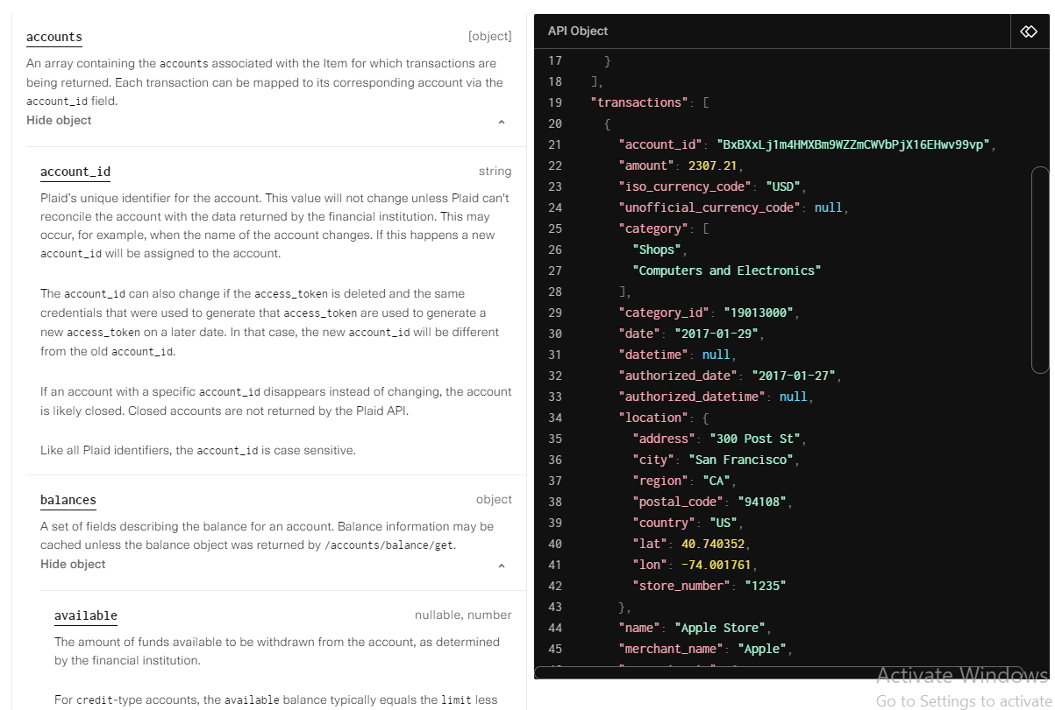
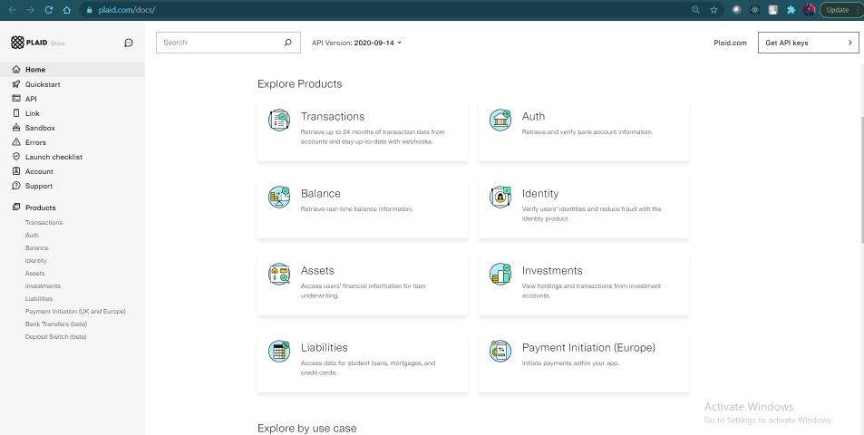
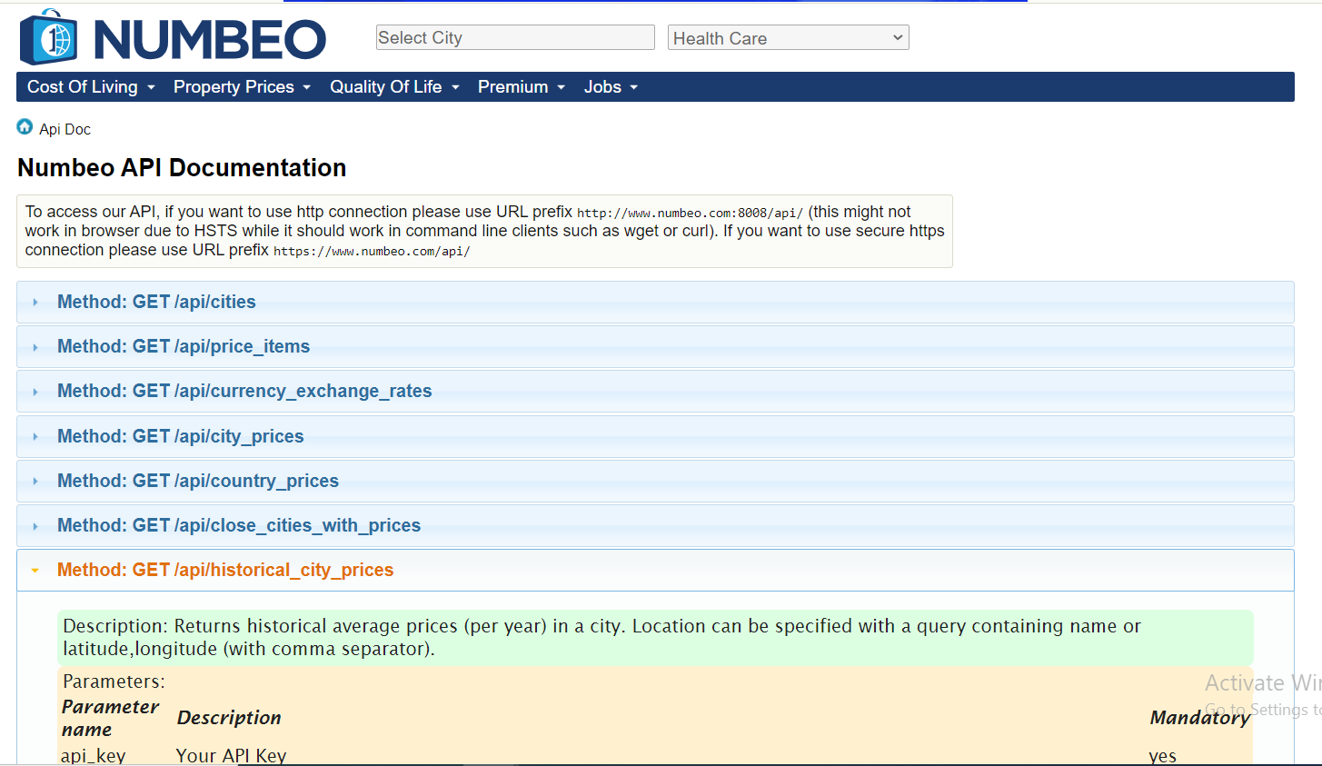
APPROACH
Plaid API is used to collect various data points of user’s bank transactions, assets, liabilities, and investments (https://plaid.com/docs/).
Global factors data points are collected through Numbeo
API (https://www.numbeo.com/api/doc.jsp).
This data points are used to create a chart explaining user’s
retirement corpus year wise.

Slide 9
CODE
GitHub repo:
https://github.com/sid3345/financial-tech
YouTube video created earlier (more features are added, not updated in video):
https://www.youtube.com/watch?v=h5lV7q0qrMw

Slide 10
CHALLENGES
Lone Wolf, lack of good MERN stack developers to team up, to code application, no guidance, thus, if selected, may be we can get more guidance.
API latencies. (API’s are sometimes slow in responding. Need proper test and error cases: code quality)
Redux, 1st time. (Learned and used React-Redux for 1st time)

Slide 11
TECH STACK
MERN stack:
MongoDB (Database)
Express
ReactJS (FrontEnd)
NodeJS (BackEnd)
D3 JS (chart visualization)
Material UI
API’s (Plaid, Numbeo)

Slide 12
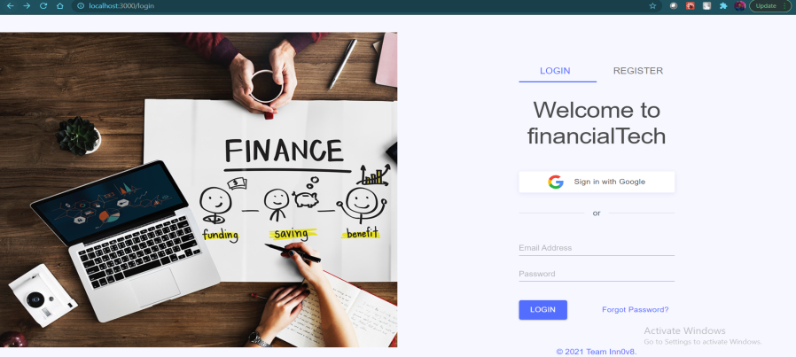
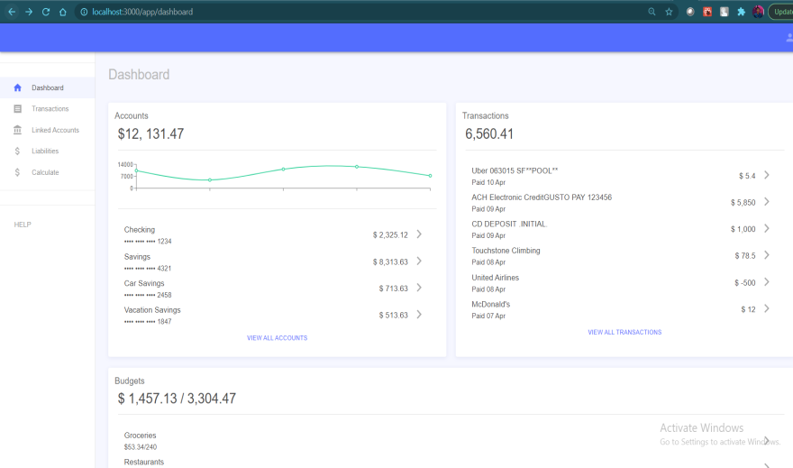
SCREENSHOTS
Login Page
Dashboard

Slide 13
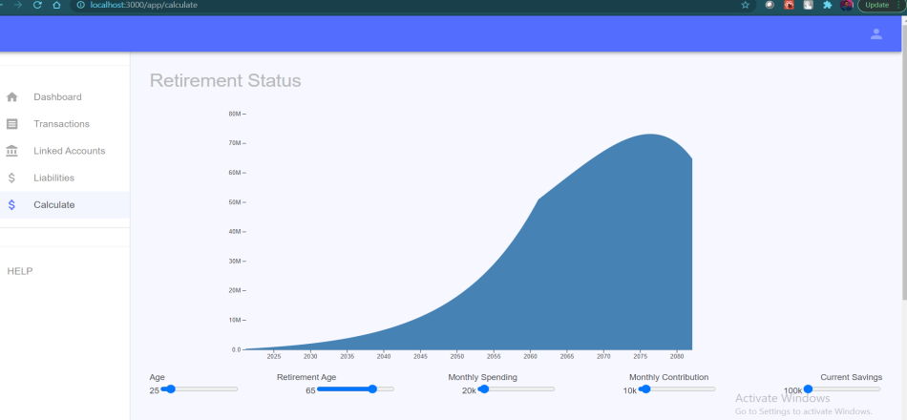
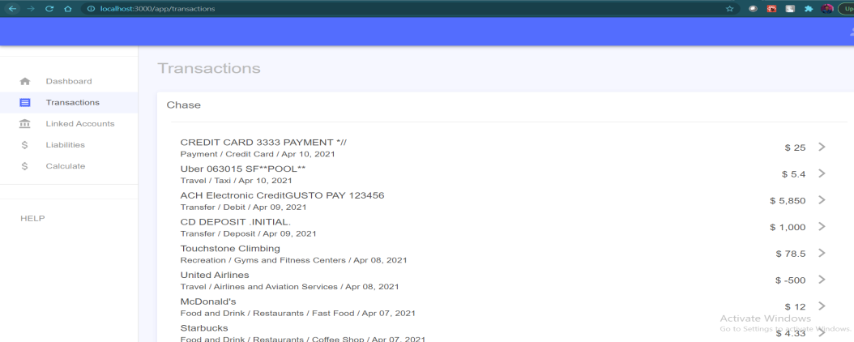
SCREENSHOTS
Retirement status
Transactions

Slide 14
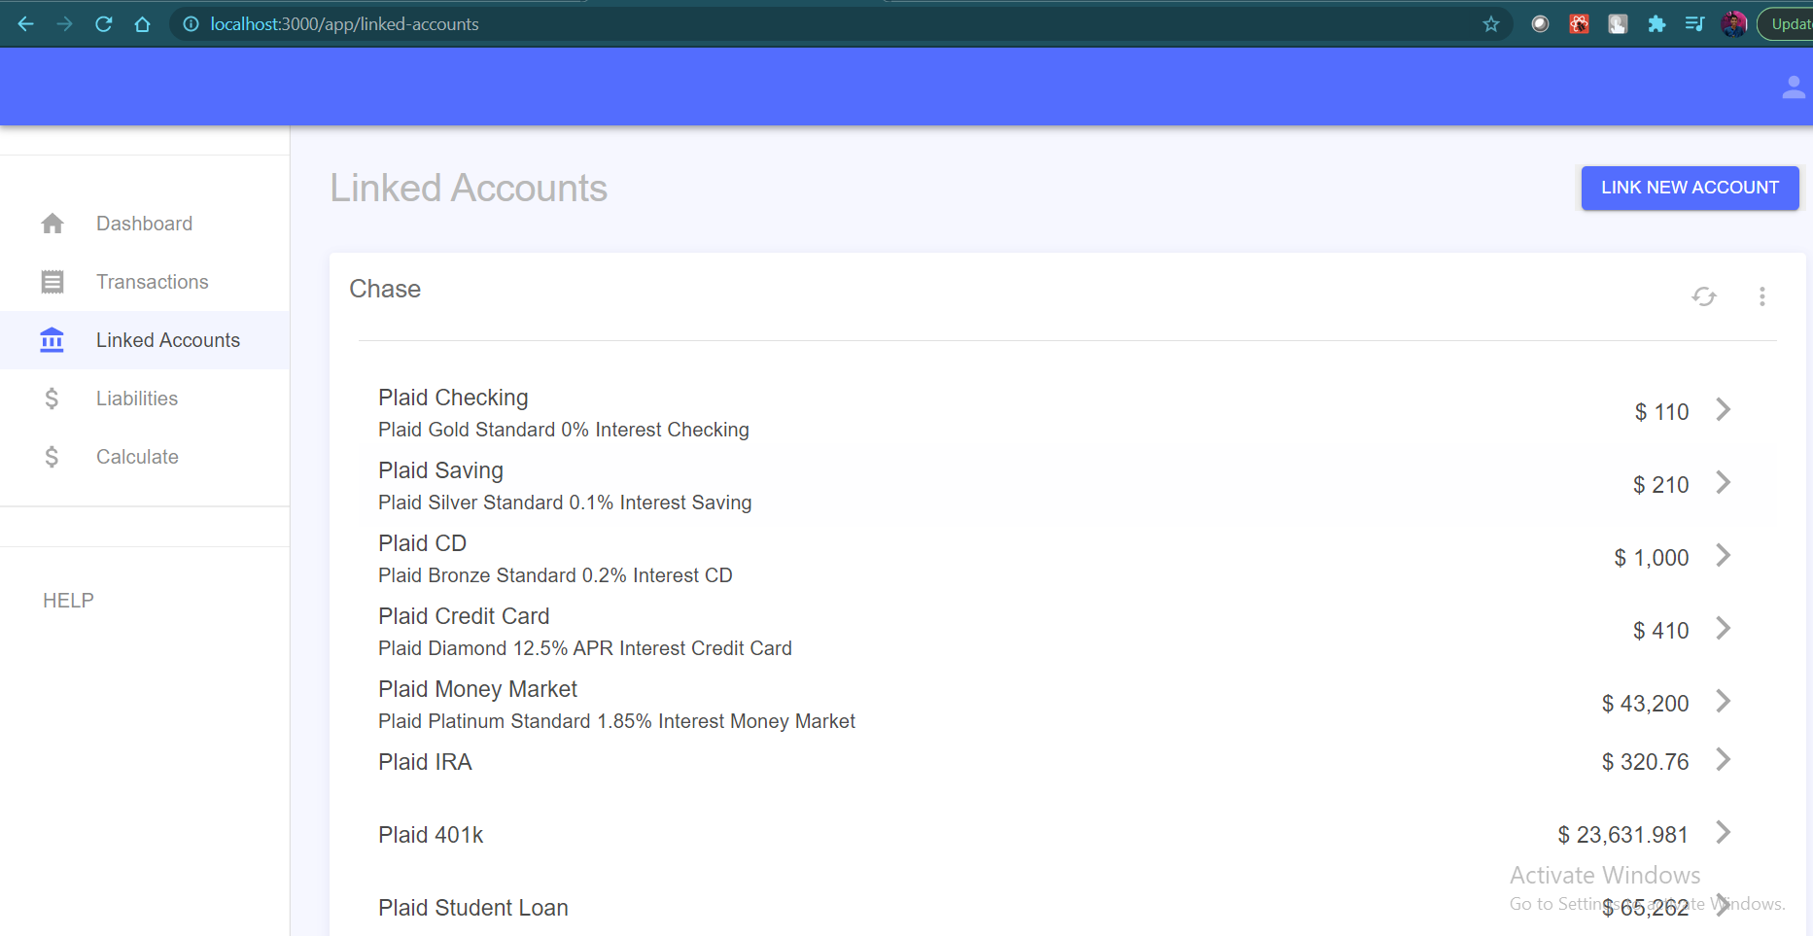
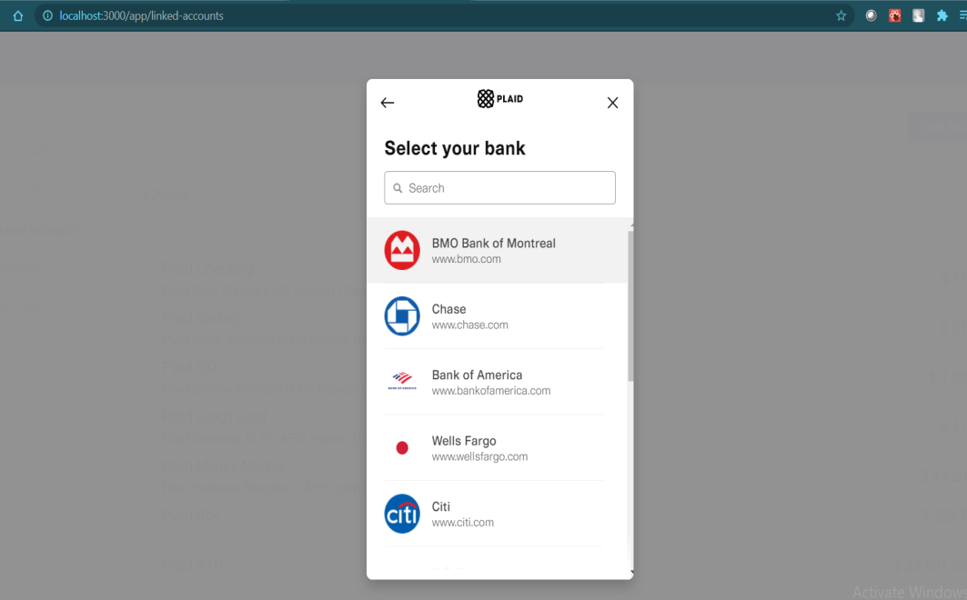
SCREENSHOTS
Plaid bank account linking
Linked Bank Accounts

Slide 15
CONCLUSION
So, we hope, using our application will help people in better retirement planning, and getting insights like at what age, what monthly amount, investments, inflation rates, location specific factors such as healthcare quality and expenses, lifestyle quality, etc, to get a complete understanding of current and future financial status.
The solution uses actual data points of users and global factors, rather than abstract thinking, thus, data never lies and is quite accurate!

Slide 16
THANK YOU

